Slide 1
C/C++ Program Design
CS205
Prof. Shiqi Yu (于仕琪)
yusq@sustech.edu.cn
http://faculty.sustech.edu.cn/yusq/

Slide 2
C/C++ with ARM

Slide 3


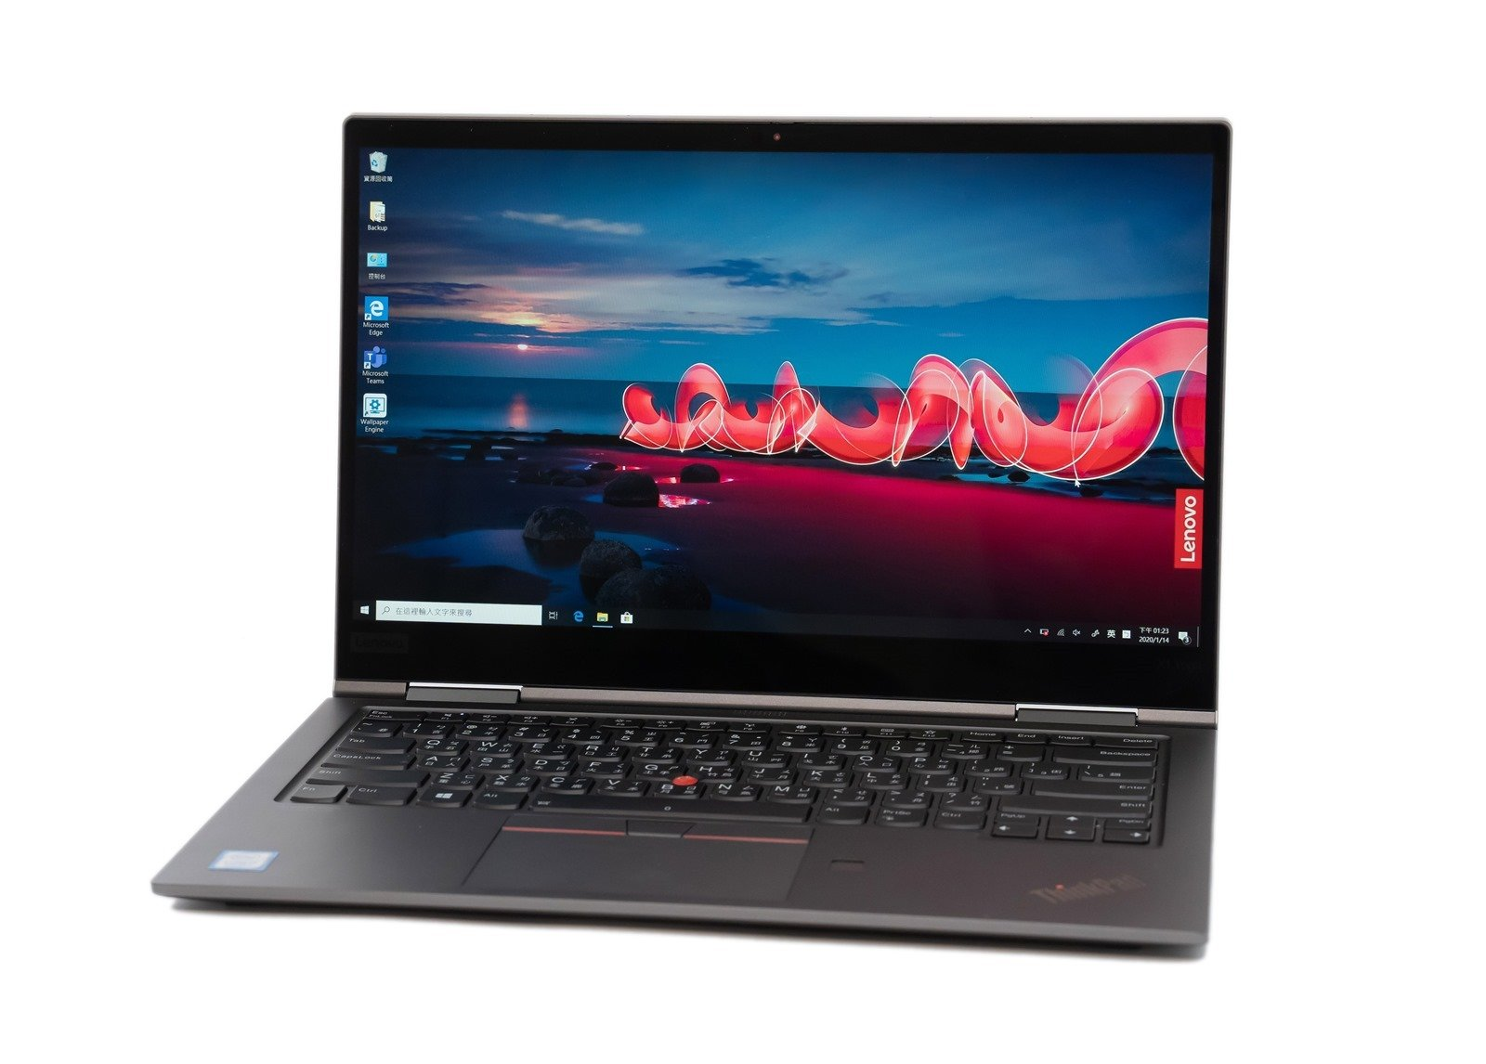

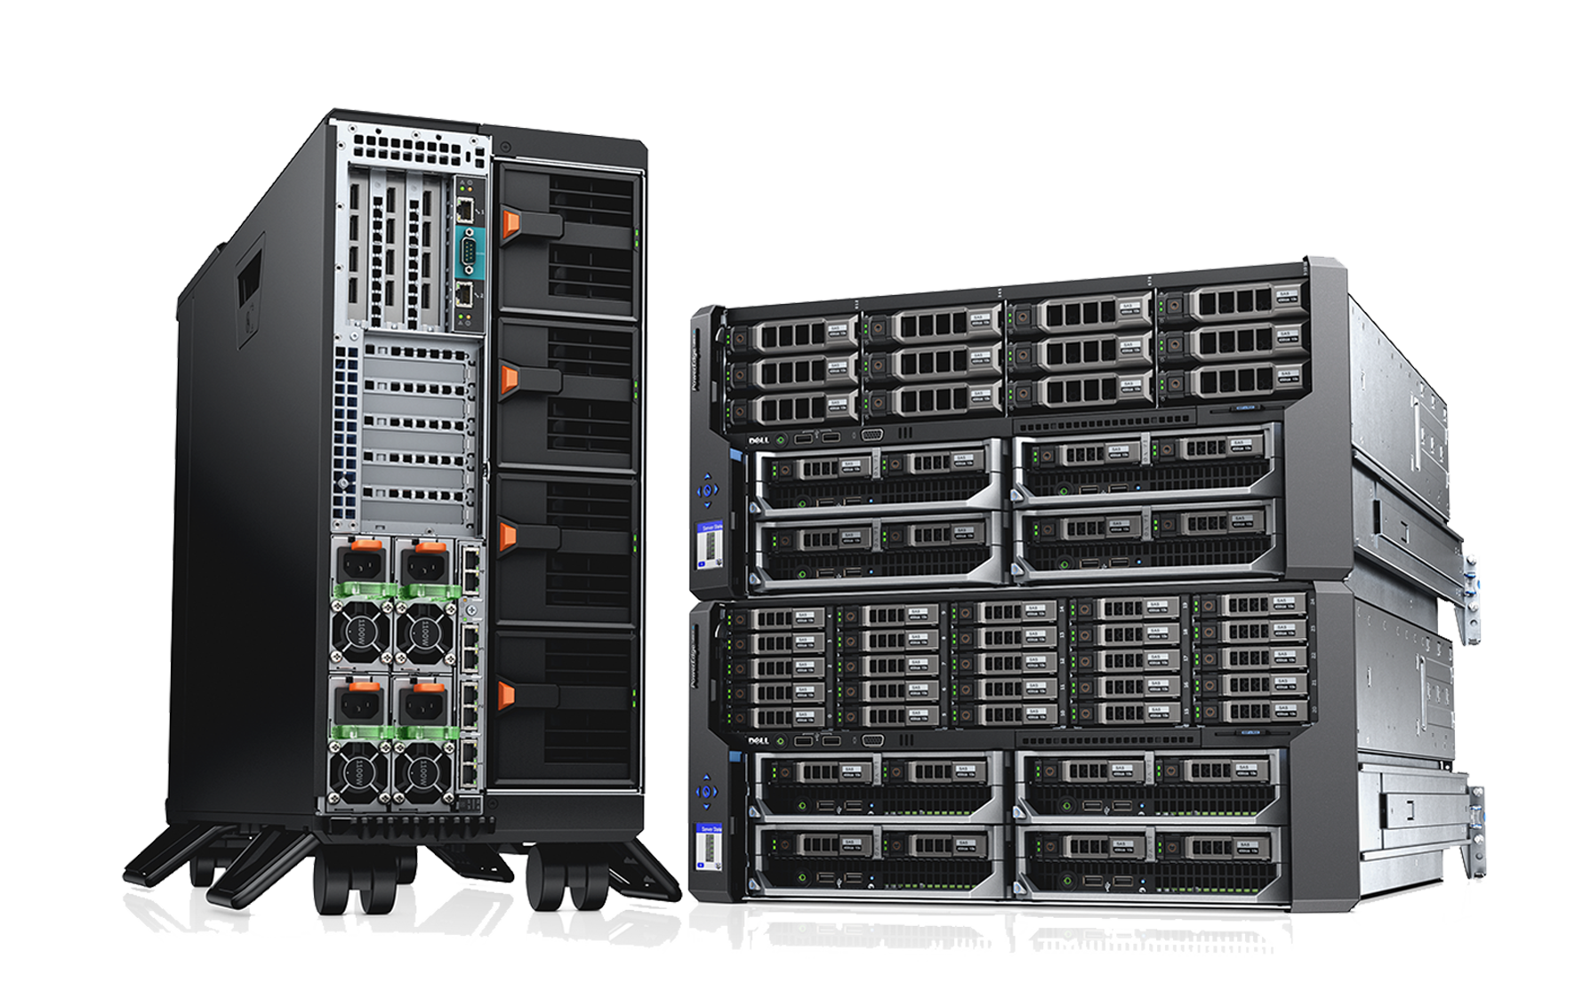
Intel vs ARM
With the help of C/C++ compilers, C and C++ are platform independent.
But we need to know some background information on different CPUs.
Intel achieved a dominant position the personal computer market. But recently ...

Slide 4

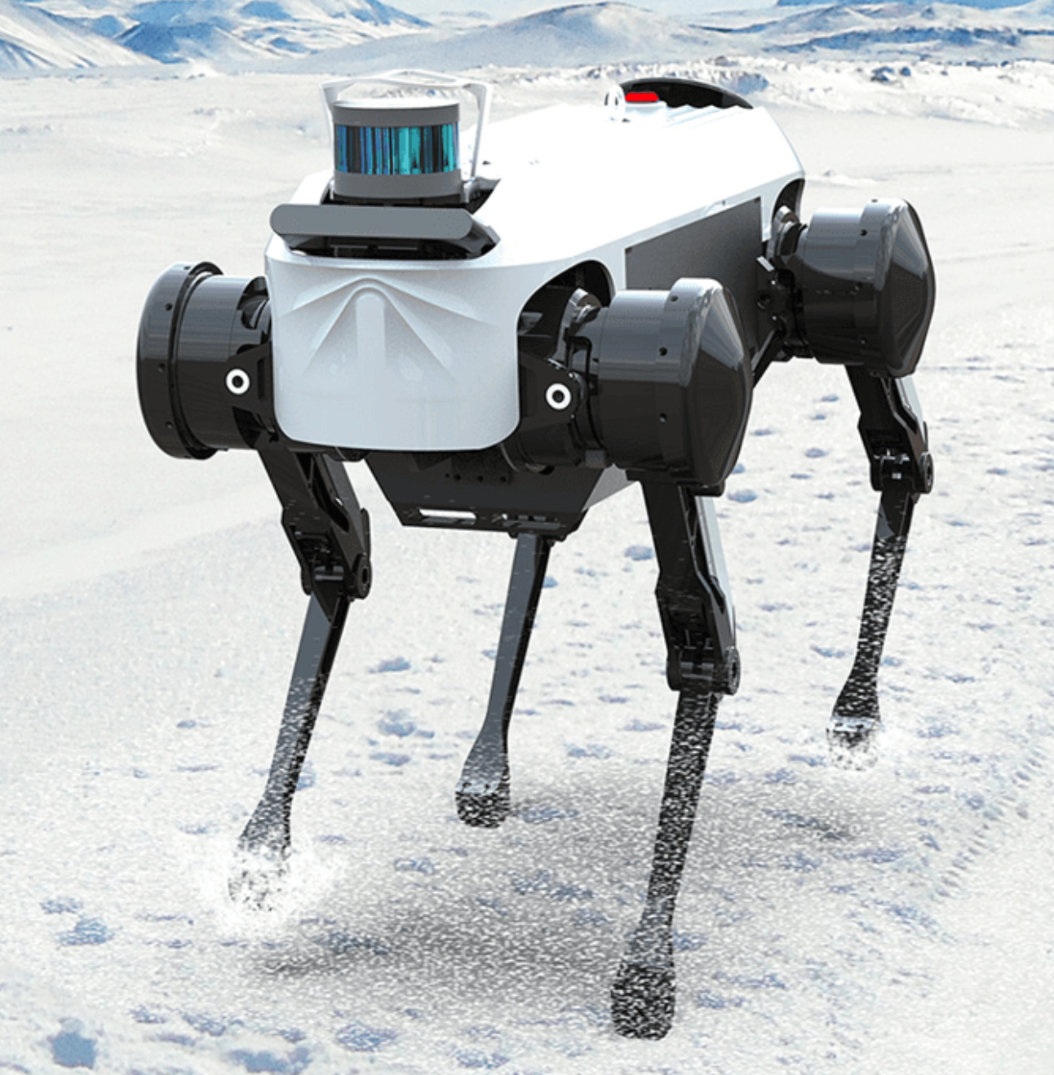
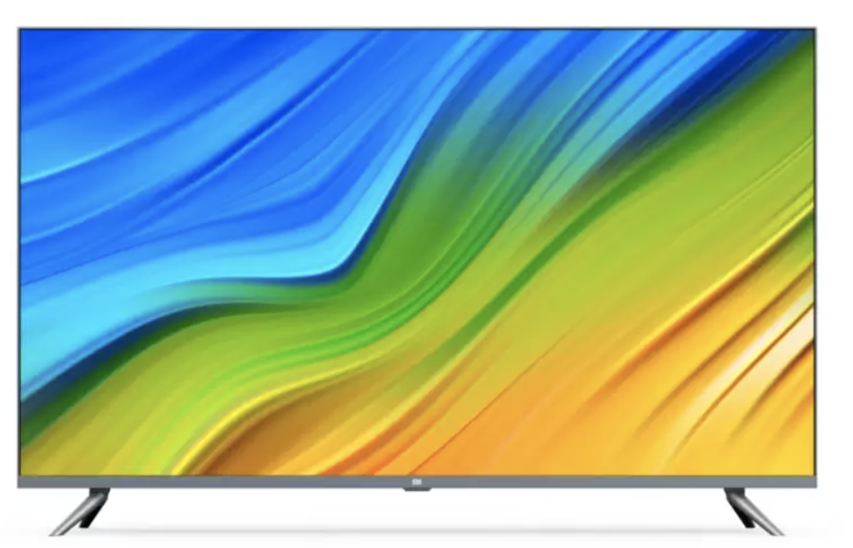
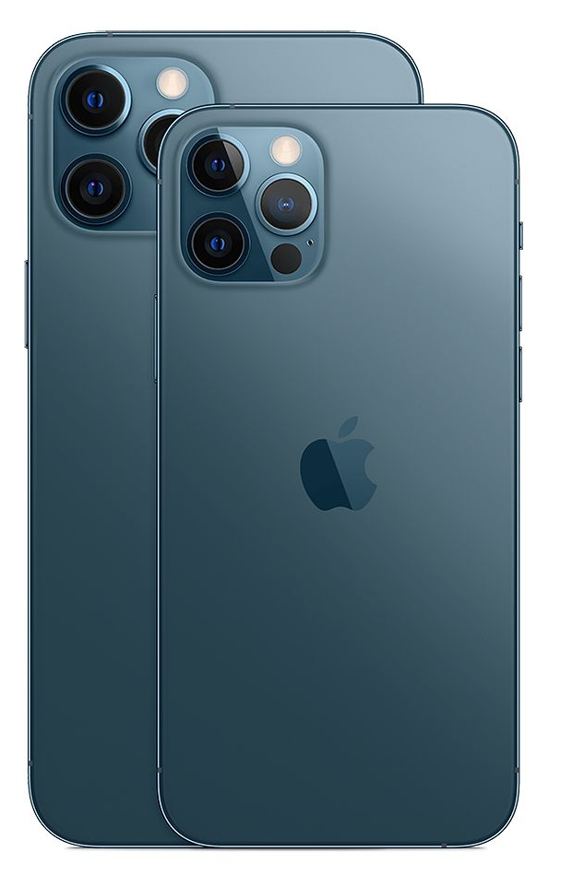
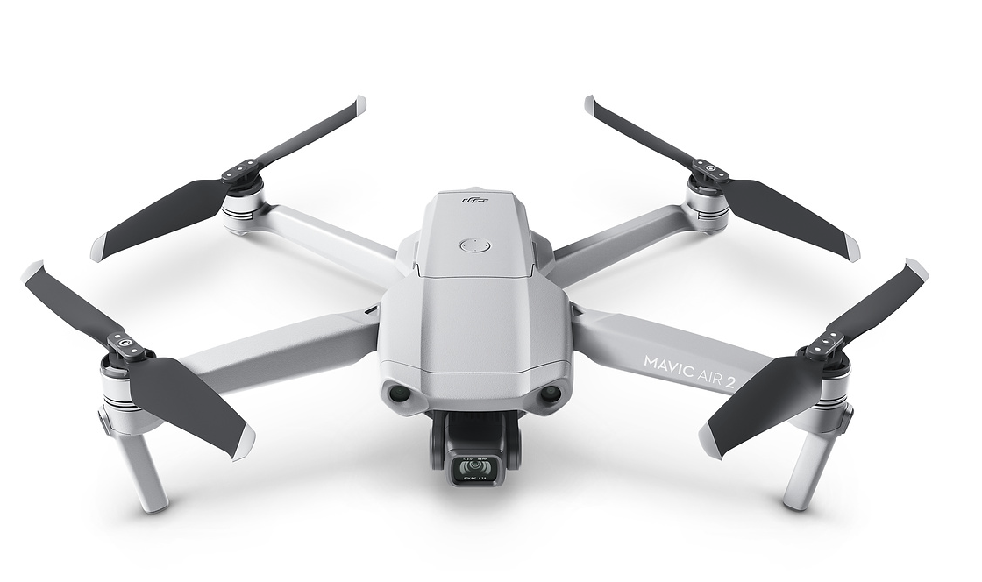
ARM
ARM (previously an acronym for Advanced RISC Machine and originally Acorn RISC Machine) is a family of reduced instruction set computing (RISC) architectures for computer processors¹.
ARM is the most widely used instruction set architecture (ISA) and the ISA produced in the largest quantity.
1. https://en.wikipedia.org/wiki/ARM_architecture

Slide 5

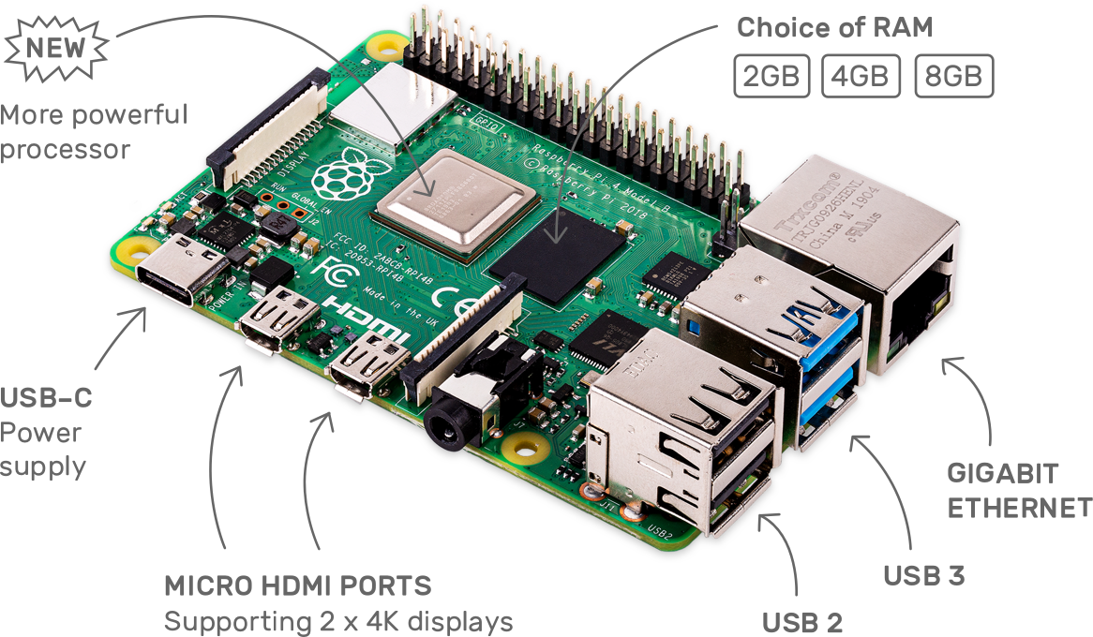
Raspberry Pi 4
https://www.raspberrypi.org/
Broadcom BCM2711, Quad core Cortex-A72 (ARM v8) 64-bit SoC @ 1.5GHz
2GB, 4GB or 8GB LPDDR4-3200 SDRAM (depending on model)
2.4 GHz and 5.0 GHz IEEE 802.11ac wireless, Bluetooth 5.0, BLE
Gigabit Ethernet
2 USB 3.0 ports; 2 USB 2.0 ports.
Raspberry Pi standard 40 pin GPIO header (fully backwards compatible with previous boards)
2 × micro-HDMI ports (up to 4kp60 supported)

Slide 6
How to develop programs with ARM Development boards
Almost the same with an X86 PC with Linux OS.
gcc/g++
Makefile
cmake

Slide 7
Speedup Your Program

Slide 8
Principle for Programming
Simple is Beautiful !
Short
Simple
Efficient

Slide 9
Some Tips on Optimization
Choose an appropriate algorithm
Clear and simple code for the compiler to optimize
Optimize code for memory
Do not copy large memory
No printf()/cout in loops
Table lookup (sin(), cos() ...)
SIMD, OpenMP

Slide 10
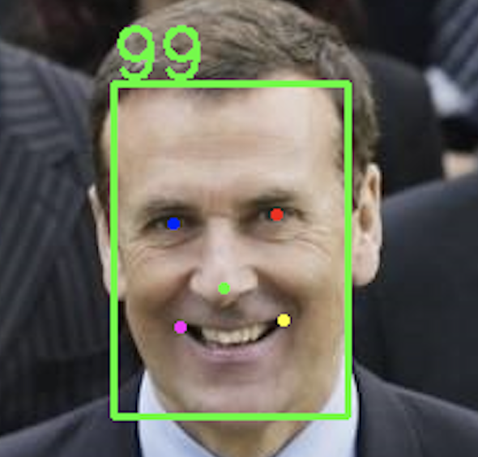
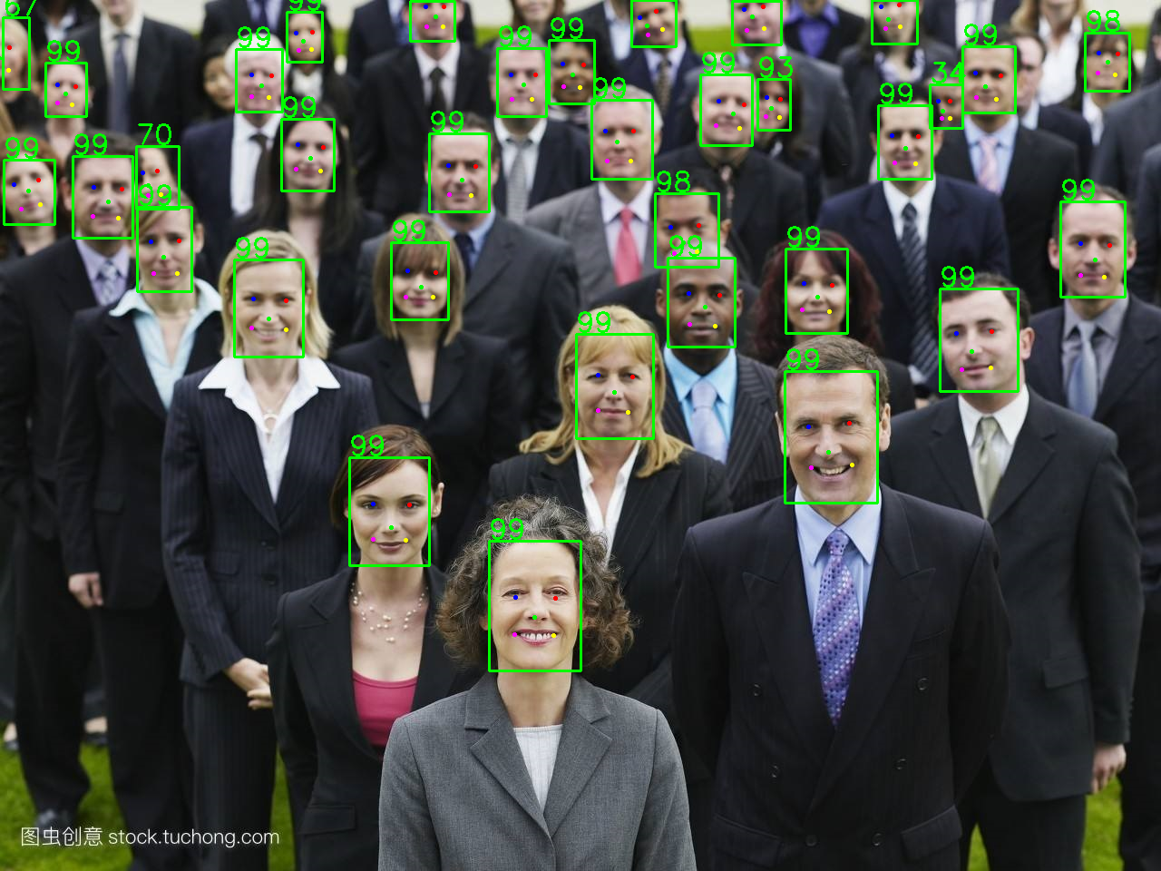
An example: libfacedetection
Face detection and facial landmark detection in 1600 lines of source code
facedetectcnn.h :
400 lines
CNN APIs
facedetectcnn.cpp:
900 lines
CNN function definitions
facedetectcnn-model.cpp:
300 lines
Face detection model
facedetectcnn-int8data.cpp
CNN model parameters in static variables
https://github.com/ShiqiYu/libfacedetection/

Slide 11
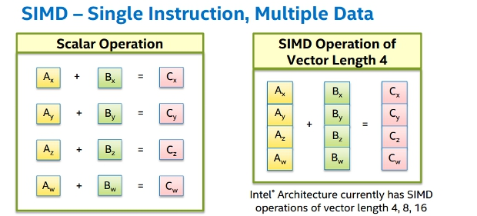
SIMD: Single instruction, multiple data
Intel: MMX, SSE, SSE2, AVX, AVX2, AVX512
ARM: NEON
RISC-V: RVV(RISC-V Vector Extension)
https://software.intel.com/sites/landingpage/IntrinsicsGuide/

Slide 12

SIMD in OpenCV
"Universal intrinsics" is a types and functions set intended to simplify vectorization of code on different platforms.
https://docs.opencv.org/master/df/d91/group__core__hal__intrin.html
使用OpenCV中的universal intrinsics为算法提速(1)(2)(3)
https://mp.weixin.qq.com/s/_dFQ9lDu-qjd8AaiCxYjcQ
https://mp.weixin.qq.com/s/3UmDImwlQwGX50b1hvz_Zw
https://mp.weixin.qq.com/s/XtV2ZUwDq8sZ8HlzGDRaWA

Slide 13

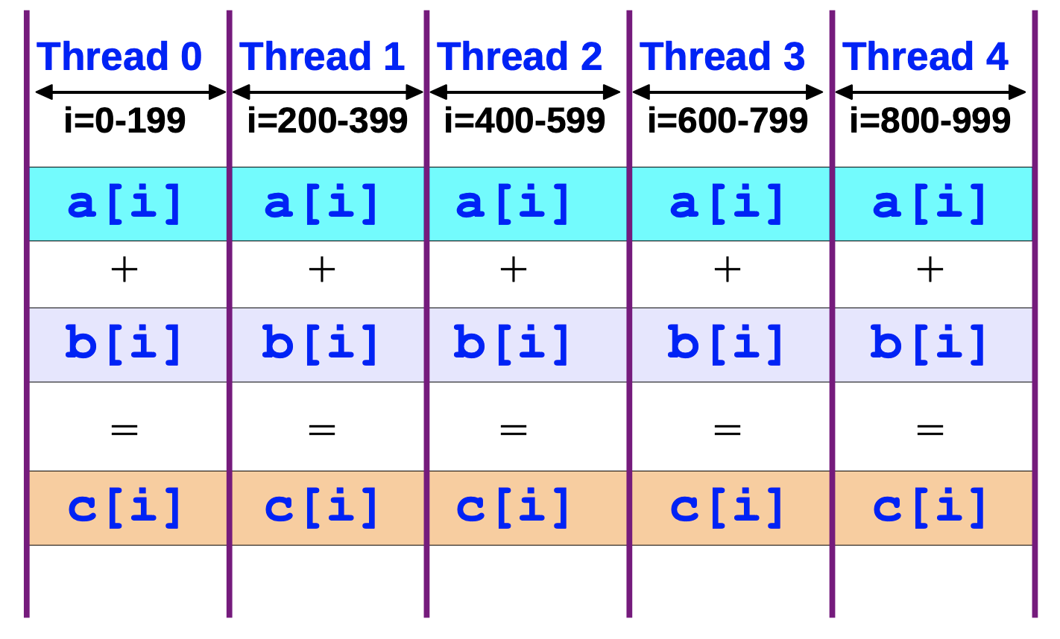
An Overview of OpenMP – Ruud van der Pas – Sun Microsystems https://www.openmp.org/wp-content/uploads/ntu-vanderpas.pdf
#include <omp.h>
#pragma omp parallel for
for (size_t i = 0; i < n; i++)
{
c[i] = a[i] + b[i];
}

Slide 14
Where should #pragma be? The 1st loop or the 2nd?
#include <omp.h>
#pragma omp parallel for
for (size_t i = 0; i < n; i++)
{
//#pragma omp parallel for
for (size_t j = 0; j < n; j++)
{
//...
}
}

Slide 15
An Example with SIMD and OpenMP

Slide 16
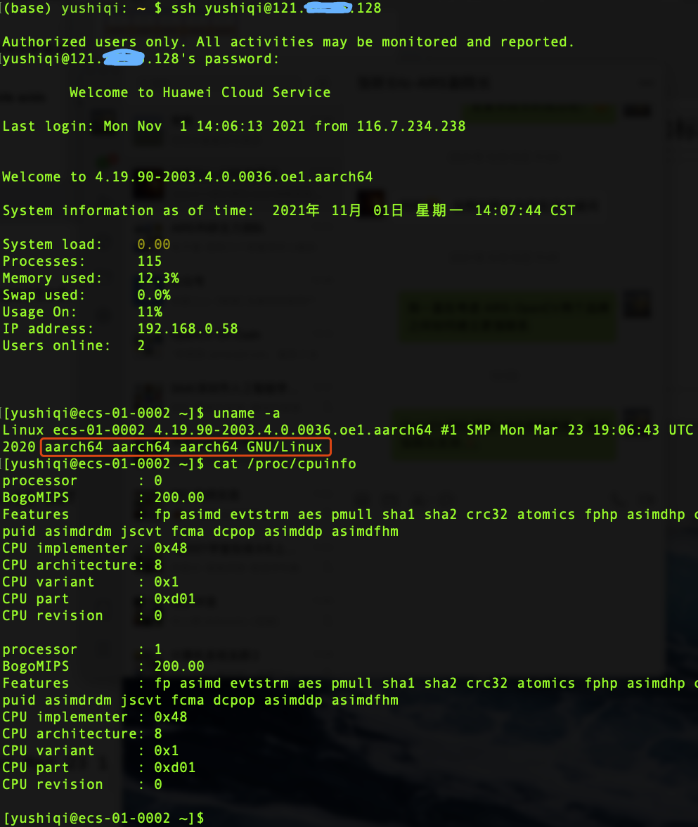
ARM Cloud Server
Huawei ARM Cloud Server
Kunpeng 920 (2 cores of many)
RAM: 3GB
openEuler Linux

Slide 17
Functions for dot product
float dotproduct(const float *p1, const float * p2, size_t n);
float dotproduct_unloop(const float *p1, const float * p2, size_t n);
float dotproduct_avx2(const float *p1, const float * p2, size_t n);
float dotproduct_avx2_omp(const float *p1, const float * p2, size_t n);
float dotproduct_neon(const float *p1, const float * p2, size_t n);
float dotproduct_neon_omp(const float *p1, const float * p2, size_t n);

Slide 18
Avoid Memory Copy
A trick in OpenCV

Slide 19
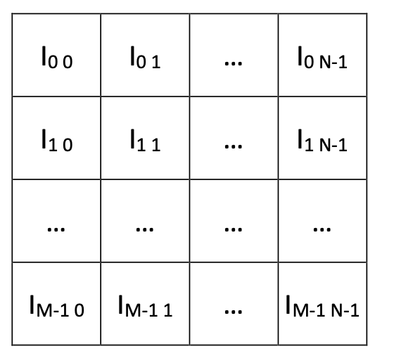
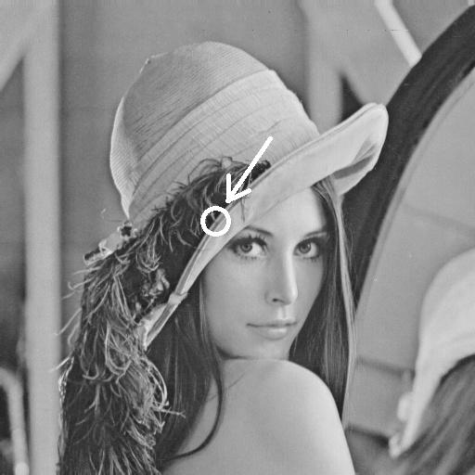

What’s an image?

Slide 20
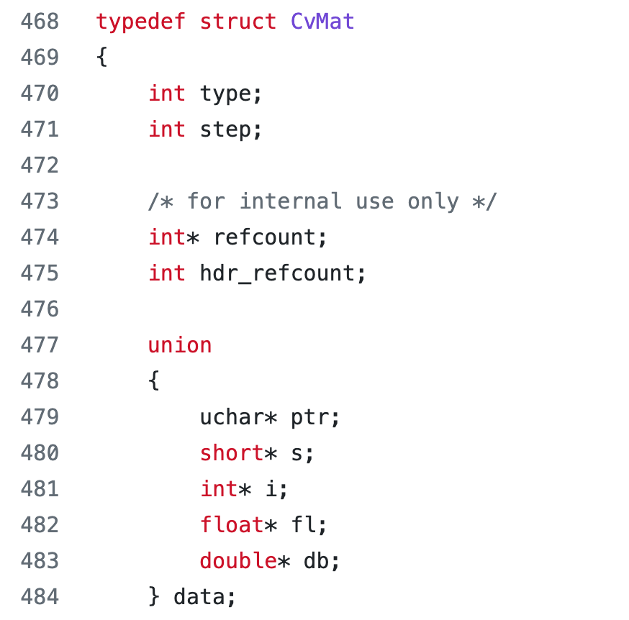
cvMat struct
modules/core/include/opencv2/core/types_c.h

Slide 21
step in CvMat struct
How many bytes for a row of Matrix 4(row)x3(col)?
Can be 3, 4, 8, and any other values >=3.
Memory alignment for SIMD

Slide 22
ROI: Region of interest
Mat A
rows=100
cols=100
step=100
data=0xABCDEF00
Mat B
rows=100
cols=100
step=100
data=0xABCDEF00
Mat C
rows=30
cols=28
step=100
data=0xABCE0698

